Slide 1
PSYC 741 Hierarchical Linear Modeling
Session 5 – Random slopes models

Slide 2
Overview of Today’s Class
Lecture and Discussion
Random Slopes Models
R tutorial
Random slopes models using lmer()
In-Class Assignment

Slide 3
Random Slopes Models
Overview
Example from textbook
Model Equation
Interpretation of effects

Slide 4
Random Slopes Models (Overview)
A multilevel regression model with at least one slope coefficient (i.e., Bs) allowed to vary across the groups/clusters
Random slopes/coefficient models can also include a random intercept in the model (in fact, this is usually the case)
Just because one slope coefficient has a random effect in the model does not mean all slope coefficients need random effects
Can be based on theory or exploratory reasons

Slide 5
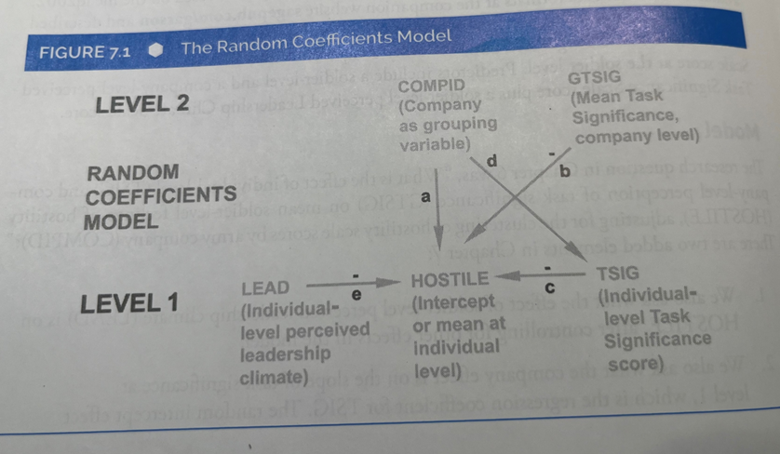
Example from Textbook
Notes:
Total 7 parameters are being estimated
4 fixed effect
2 random effects
1 residual error

Slide 6
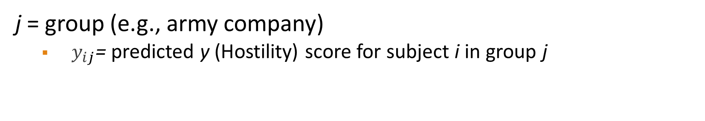
Example Formula
$$y_{ij}=β_{0_{j}}+{β_{1_{j}}∗\left(TSIG\right)+β_{2}∗\left(GTSIG\right)+β_{3}∗(LEAD)+ e}_{ij}$$
j = group (e.g., army company)
$y_{ij}$= predicted y (Hostility) score for subject i in group j

Slide 7
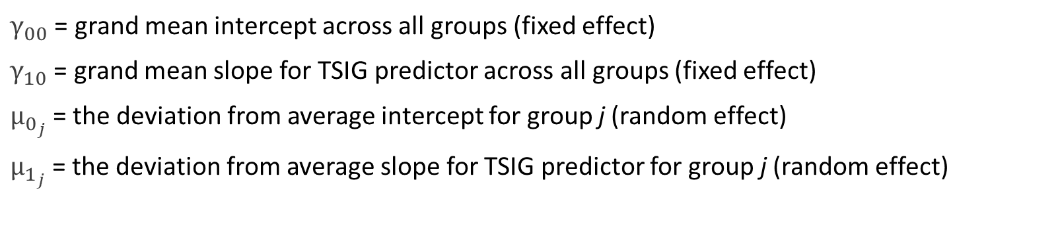


Random Intercept Included
$$y_{ij}=β_{0_{j}}+{β_{1_{j}}∗\left(TSIG\right)+β_{2}∗\left(GTSIG\right)+β_{3}∗(LEAD)+ e}_{ij}$$
$$β_{0_{j}}=γ_{00}+ μ_{0_{j}}$$
$$β_{1_{j}}=γ_{10}+ μ_{1_{j}}$$
$$y_{ij}=γ_{00}+ μ_{0_{j}}+{(γ_{10}+ μ_{1_{j}})∗\left(TSIG\right)+β_{2}∗(GTSIG)+β_{3}∗(LEAD)+e}_{ij}$$
$γ_{00}$ = grand mean intercept across all groups (fixed effect)
$γ_{10}$ = grand mean slope for TSIG predictor across all groups (fixed effect)
$μ_{0_{j}}$= the deviation from average intercept for group j (random effect)
$μ_{1_{j}}$= the deviation from average slope for TSIG predictor for group j (random effect)

Slide 8
Interpretation of Fixed Effects Slopes
Similar as the interpretation from a traditional OLS regression model.
E.g., A one unit increase in X is associated with a B change in Y, adjusting for the other variables in the model.
The general interpretation is similar for Level 1 and Level 2 fixed effects.
Level 1: A one-unit increase of X1 at the individual level is associated with a B1 change in Y…
Level 2: A one-unit increase of X2 at the group level is associated with a B2 change in Y…

Slide 9
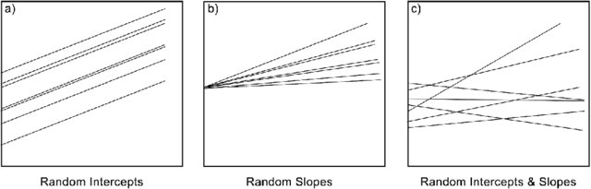
Interpretation of Random Effects Slopes
The fixed effect slope can be seen as the average (mean) slope across the entire sample
The random effect slope is the variance of this effect across the groups/clusters

Slide 10
Covariance Structures (Recap)
Different ways to estimate the variance/covariance of the random effects in a model with multiple random effects
Types (among others):
Variance components (VC): usually the default for random effects. Assumes independence (i.e., covariance of 0) among random effects.
Diagonal (DIAG): usually the default in repeated measures models.
Unstructured (UN): all variances and covariances are estimated (i.e., no constraints). More complex as a result and more likely to lead to convergence issues.
Notes:
VC – (1 | COMPID) + (1 | COMPID : TSIG)
UN – (1 + TSIG | COMPID) → Results in three random effects. The last one = covariance of the two random effects (slope & intercept)

Slide 11
Next Class
Lecture Topics:
Moderation and Interactions in Multilevel Models
R
Creating mean-centered variables
Interactions effects in MLMs
Readings that will be discussed
Enders & Tofighi (2007), Andersson, Cuervo-Cazurra, & Nielsen (2014)
Contributing to your participation grade, make sure to respond to the Readings Feedback/Questions submission on Canvas
Quiz 1

